Slide 1
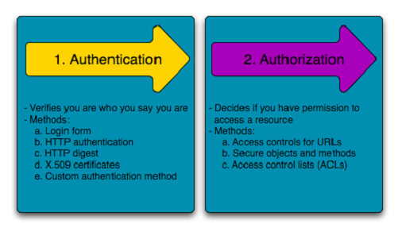
Authentication vs Authorization
Authentication means confirming your own identity, whereas authorization means being allowed access to the system. In even more simpler terms authentication is the process of verifying oneself, while authorization is the process of verifying what you have access to.

Slide 2
Authentication vs Authorization
Authentication
Authentication is about validating your credentials such as Username/User ID and password to verify your identity. The system then checks whether you are what you say you are using your credentials. Whether in public or private networks, the system authenticates the user identity through login passwords. Usually authentication is done by a username and password, although there are other various ways to be authenticated.
Based on the security level, authentication factors can vary from one of the following:
Single- Factor Authentication: This is the simplest form of authentication method which requires a password to grant user access to a particular system such as a website or a network. The person can request access to the system using only one of the credentials to verify one’s identity. For example, only requiring a password against a username would be a way to verify a login credential using single- factor authentication.
Two- Factor Authentication: This authentication requires a two- step verification process which not only requires a username and password, but also a piece of information only the user knows. Using a username and password along with a confidential information makes it that much harder for hackers to steal valuable and personal data.
Multi- Factor Authentication: This is used to ensure that digital users are who they say they are by requiring that they provide at least two pieces of evidence to prove their identity. Each piece of evidence must come from a different category: something they know, something they have or something they are.. It is common for financial organizations, banks, and law enforcement agencies to use multiple- factor authentication.

Slide 3
Authentication vs Authorization
Authorization
Authorization occurs after your identity is successfully authenticated by the system, which therefore gives you full access to resources such as information, files, databases, funds, etc. However authorization verifies your rights to grant you access to resources only after determining your ability to access the system and up to what extent. In other words, authorization is the process to determine whether the authenticated user has access to the particular resources. A good example of this is, once verifying and confirming employee ID and passwords through authentication, the next step would be determining which employee has access to which floor and that is done through authorization.

